Slide 1

Suggested Content Outline
(you don’t have to use this outline, it’s just a framework suggestion to save you time)
Slide 1: Title & Introduction
Project title & team name
Brief team introduction
Slide 2: Problem
Define the problem and its significance (include key statistics, research findings, or pain points)
Identify the data source(s) used to recognize the issue
Slide 3: Proposed solution
Describe your solution
Define your target audience
List the core technologies driving your solution
Slide 4: Prototype/Demo
Showcase a working prototype or a conceptual MVP
Explain how key features address the identified needs
Slide 5: Market Validation
Present market research insights and addressable market size
Compare with existing solutions and highlight your unique value proposition
2

Slide 2
Suggested Content Outline
Slide 6: Business Model & Scalability
Summarize your business model and potential revenue streams
Outline a clear scaling strategy and cost structure
Slide 7: Traction and Validation (optional)
Provide any evidence of user engagement or feedback received (if any)
Slide 8: Roadmap and Financial Projections (optional)
Present a timeline for development and launch
Offer brief financial projections and key milestones (e.g., break-even point)
Slide 9: Closing & Q&A
Recap the problem, solution, and market potential
Define the next steps for your project
Thank the audience and open the floor for questions
3

Slide 3
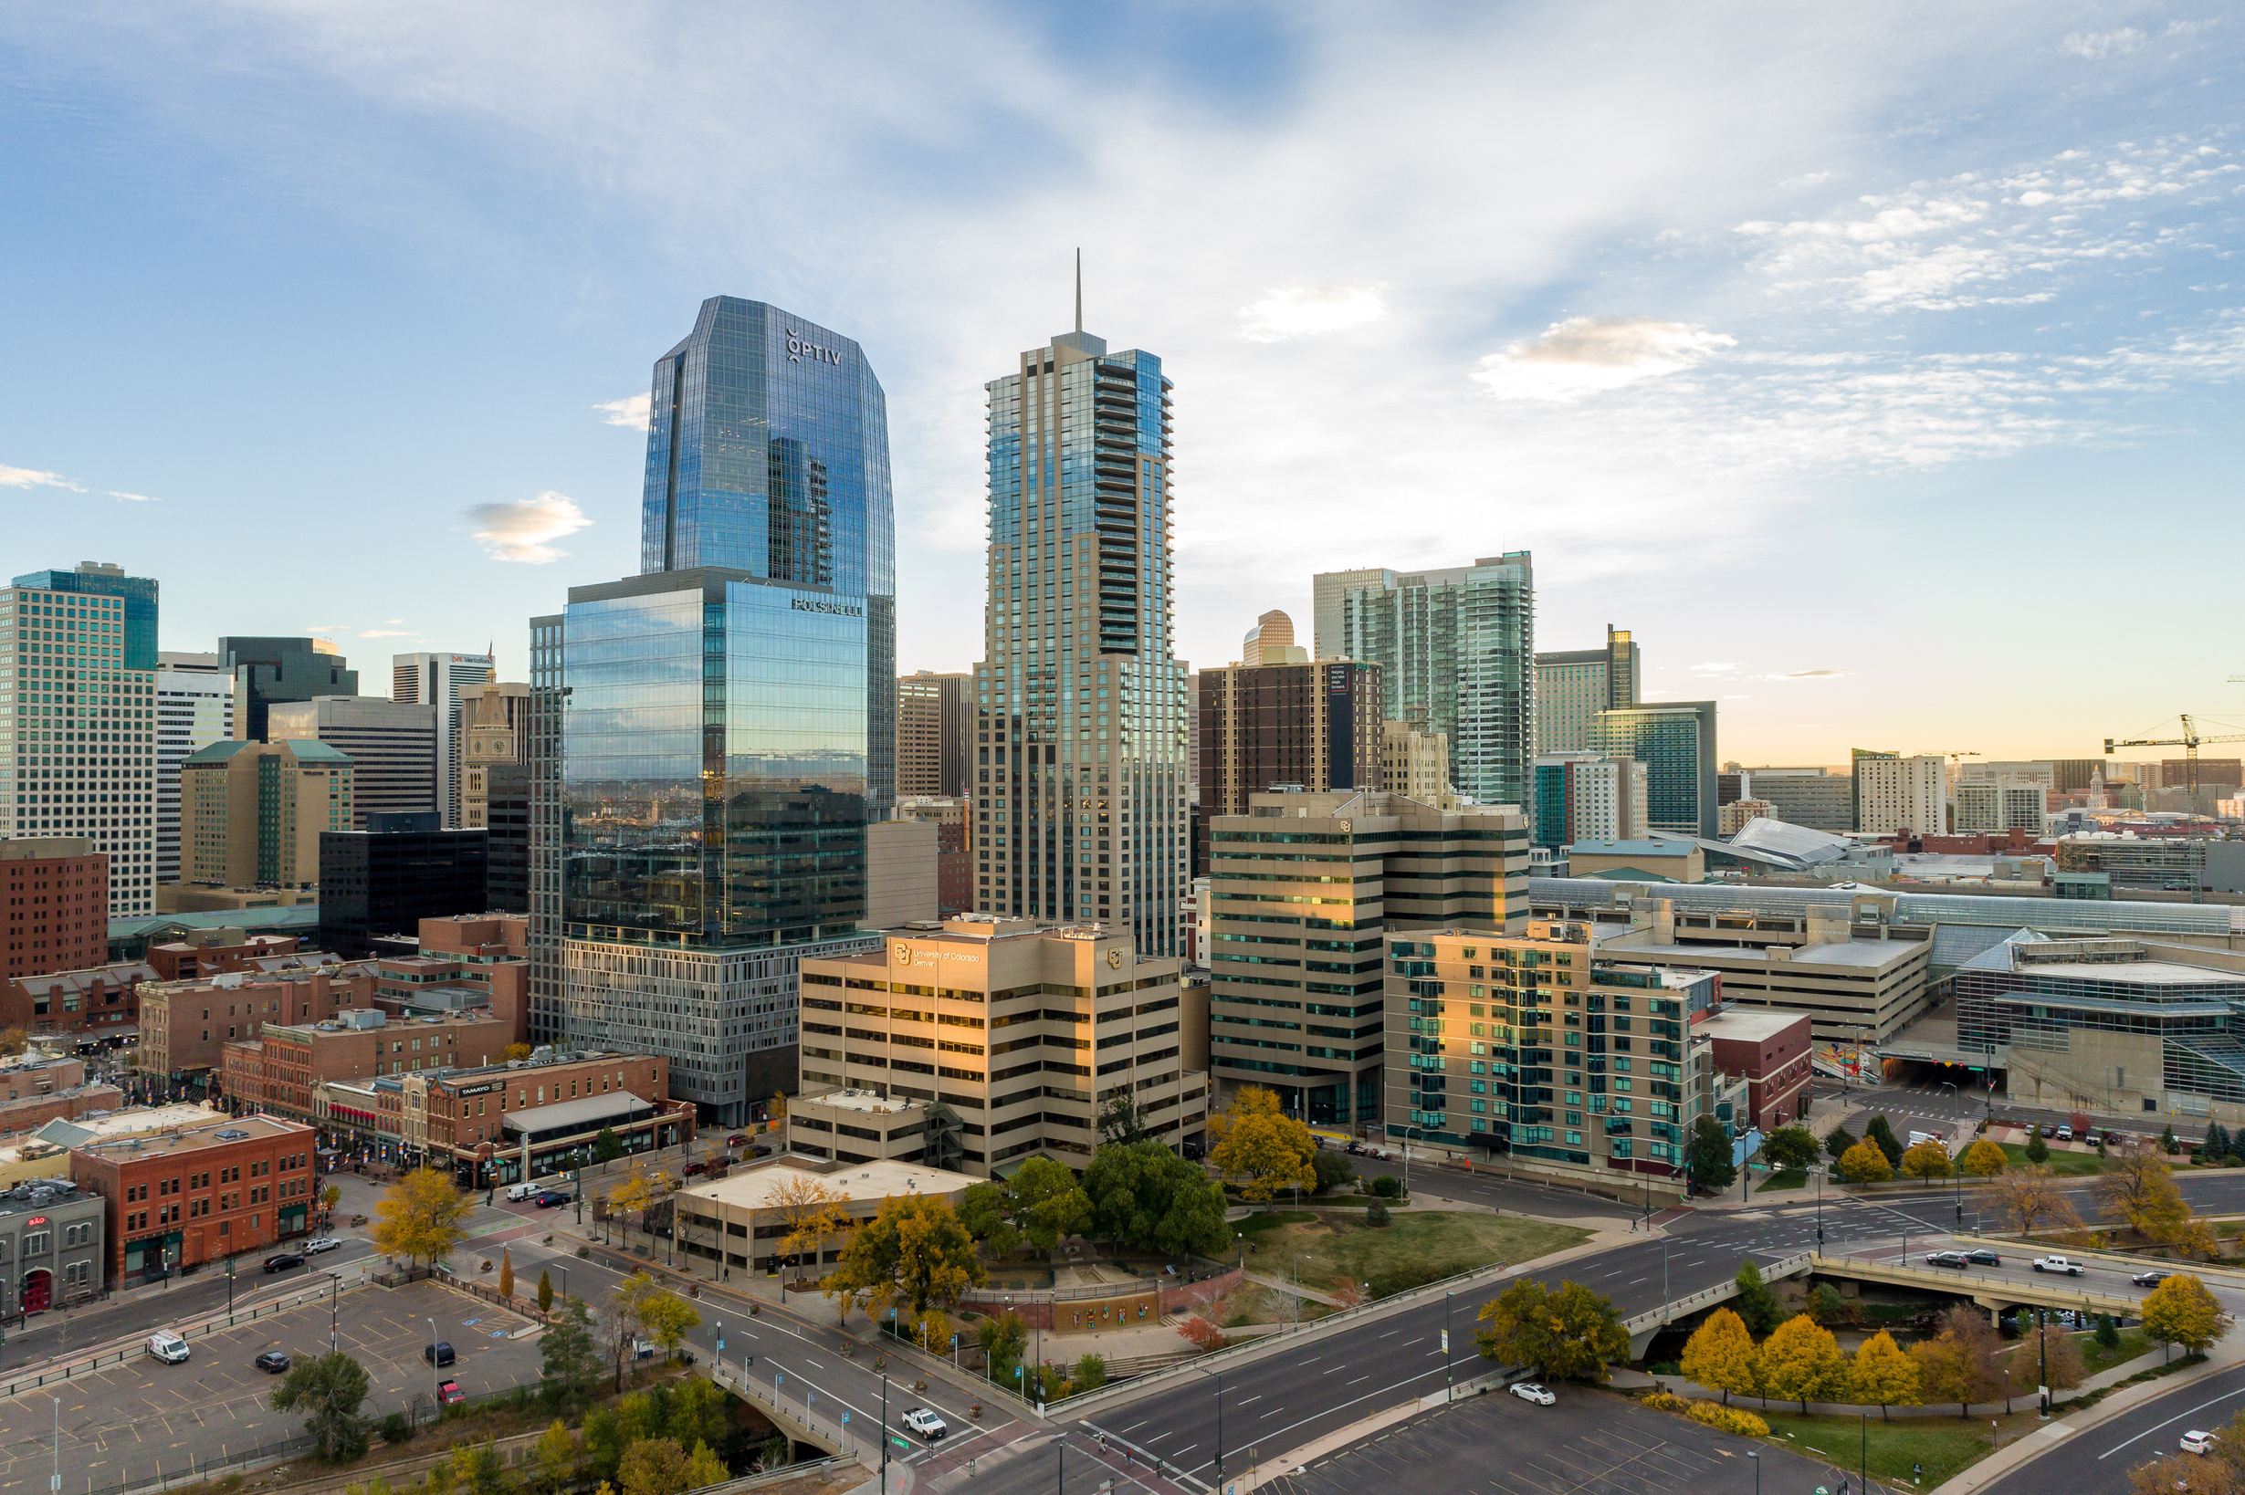

AURARIA HACK 2025
Trip Guardian
February, 18th, 2025
Wintermule
Christian Mandujano

Slide 4
In the presence of others, bystanders are less likely to intervene when they witness someone in need of help
“
”
– (Darley & Latané, 1968)
13

Slide 5





AGENDA
01
RTD Outline
02
Data
03
Model
04
Outcome
05
Future

Slide 6
RTD current issues
Construction impact
Impact on stations and routes
Speed restrictions
Municipal standards
Ridership impact
Why do people not want to ride?
Maintenance
How to decide which area might need repair from crime statistics.
8

Slide 7
Impact on User Behavior
1
Reduced Ridership at High-Crime Stops: If the application identifies certain bus stops as high-crime locations, users might avoid those stops, leading to a potential decrease in ridership at these stops.
3
Perceived Value for Users: Users might be willing to pay for premium features (e.g., safer route recommendations, real-time crime alerts) if the application significantly improves their sense of safety while traveling.
2
Shift to Safer Stops: Riders to choose safer bus stops with lower crime statistics. This could lead to higher ridership at the selected safe stops, potentially impacting local businesses and service providers.
14

Slide 8
How we improve
Area of Identification
Which areas can be more at risk based on crime statistics
Which routes can be affected?
What can we do?
9

Slide 9
Denver DATA
General Transit Feed Specification (GTFS)
Schedule data
Routes
Crime data
Denver mile High Data catalog.

Slide 10
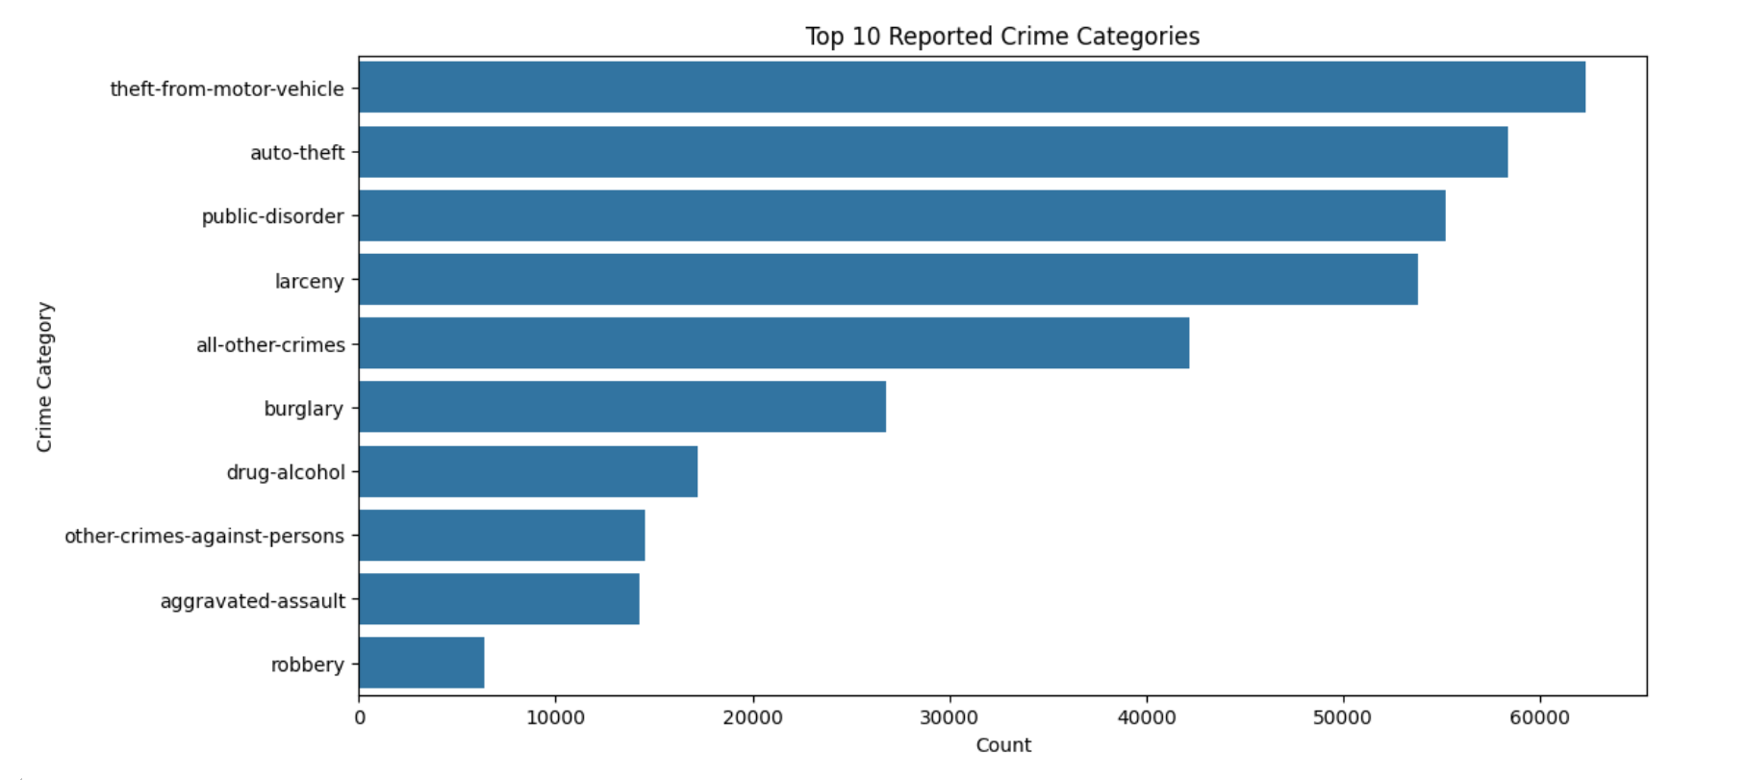
Top ten reported Crime Categories
25%
30%
50%
30%
25%
20%
25%
15%
10%
19

Slide 11
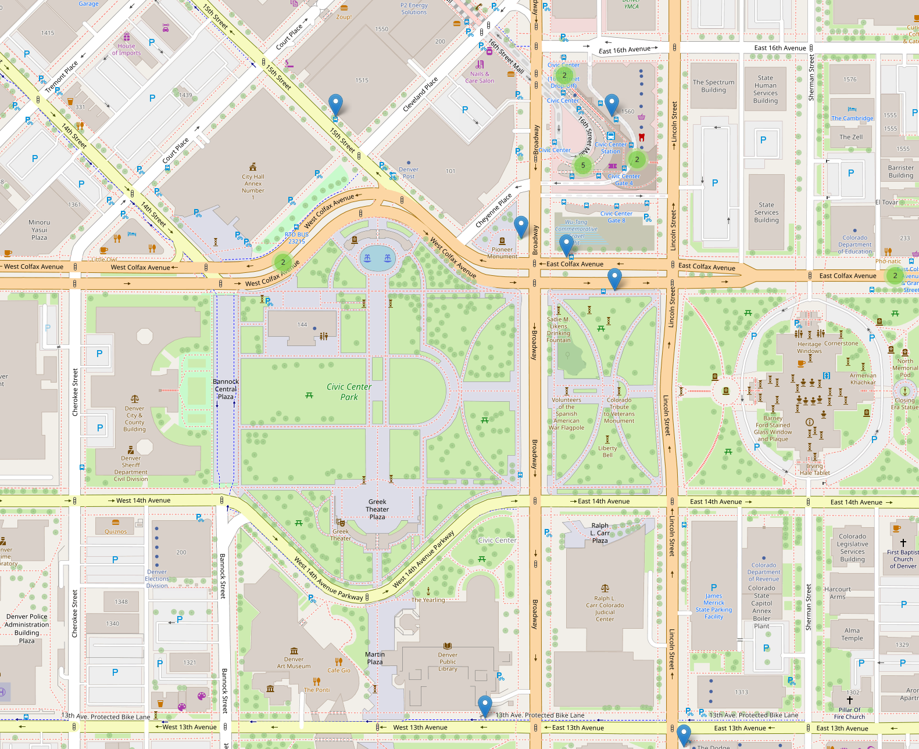
Transportation stop
A small section of downtown
12

Slide 12
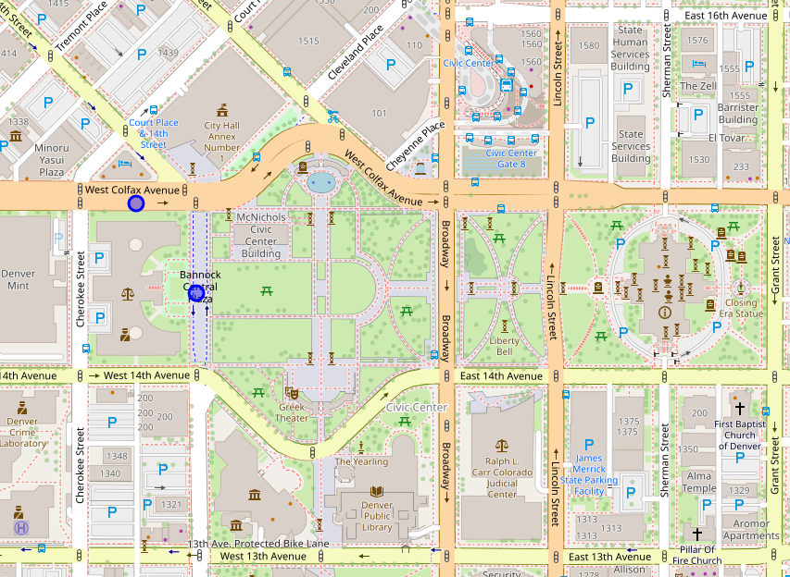
Transportation stop
A small section of downtown - Theft - Assault
12

Slide 13
What do we with this data?
1
We can identify the stops at higher risk
2
Allocate funds with the knowledge that these areas at higher risk
3
Show data that the Transit stop is highly trafficked and is a better investment
14

Slide 14
Revenue Generation Methods
3
Projection: Government or other transit agencies might provide funding for integration, such as $10,000 to $50,000 annually for data analysis and integration into existing systems.
1
Advertising: Local businesses or public services could advertise in the application, especially if the app drives more traffic to safer stops or helps with navigating crime-ridden areas. If the app targets urban areas, local advertisements can generate revenue.
2
Partnership with Local Authorities: The app could partner with local transportation or law enforcement agencies. These partnerships could involve funding for crime data collection or providing analytics to improve public safety.
14

Slide 15

Costs and Expenses
Data Costs:
Development Costs:
To obtain and maintain accurate crime data, the app would need to purchase or aggregate data from reliable sources (local police databases, third-party crime tracking services).
Developing and maintaining the app will incur upfront and ongoing costs. Integrate a small team into existing infrastructure.
STRENGTHS
WEAKNESS
OPPORTUNITIES
Potential
SWOT
Marketing and User Acquisition
Subscription
The cost to acquire users will vary based on the target market. Online marketing (e.g., social media campaigns, Google ads) could cost around $1,000 to $10,000 per month depending on the scale of campaigns.
Projection: If user acquisition costs are $5 per user and you aim for 10,000 users in the first year, marketing costs could be around $50,000 annually.
18

Slide 16









FUTURETIMELINE INTEGRATION
2026 Q1
2026 Q2
Create a more detailed map for rider comfort
Verify with rider of new changes
2025
2026 Q1
2026 Q3
2021
2023
Gather more data
Integrate in current APP
Analyze impact
Get rider and government feedback
Verify changes in a monetary figure
Add route information for the current application to increase rider accessibility due to outage and construction
16

Slide 17
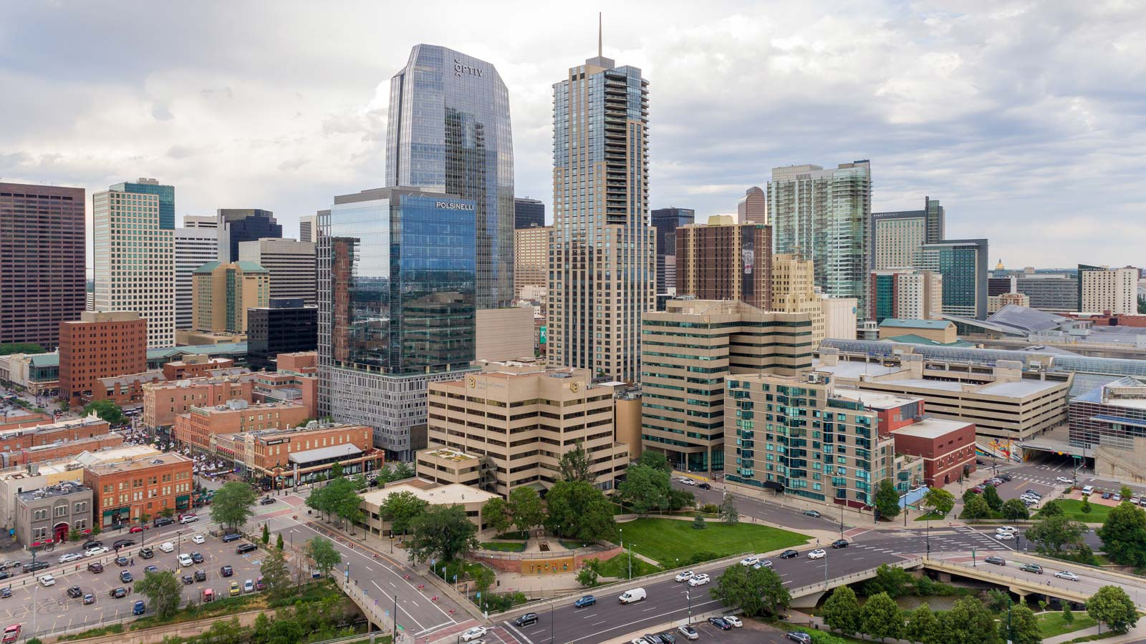
AURARIA HACK 2025
THANK YOU!
Questions are welcomed

